Slide 1

Ibm cognos Analytics
Data visualizations using
Monal Gosai C0735599
Harsh Pandya C0735693
Abhishek Juluru C0735725
Rupesh Rayanna C0719836

Slide 2
Why use Data visualizations
Comprehend information quickly
Identify relationship and patterns
Pinpoint emerging trends
Results communicates itself

Slide 3
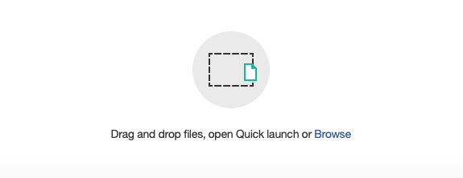
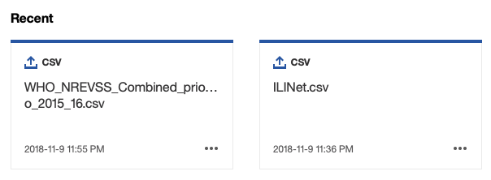
Loading data

Slide 4
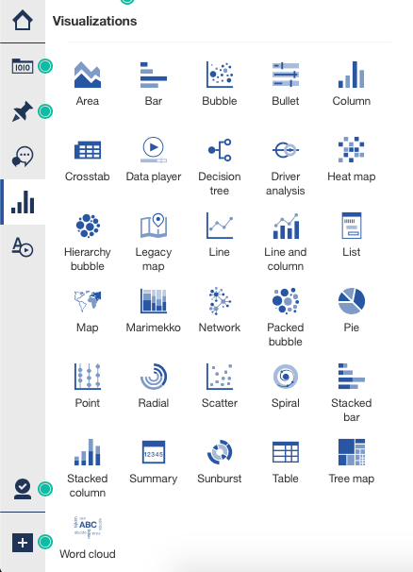
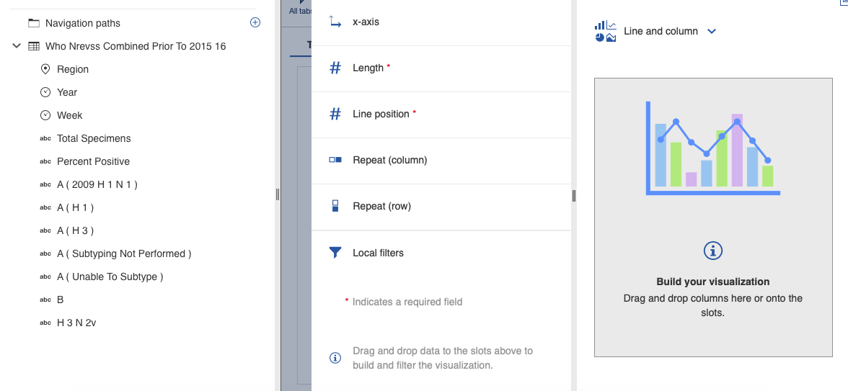
Select visualization type and plot columns

Slide 5
Data Set used
FluView Interactive Surveillance Data
ILI and viral
Hospitalization
Ili activity map
Paediatric mortality
p&i mortality
Novel flu A
Geographic spread

Slide 6
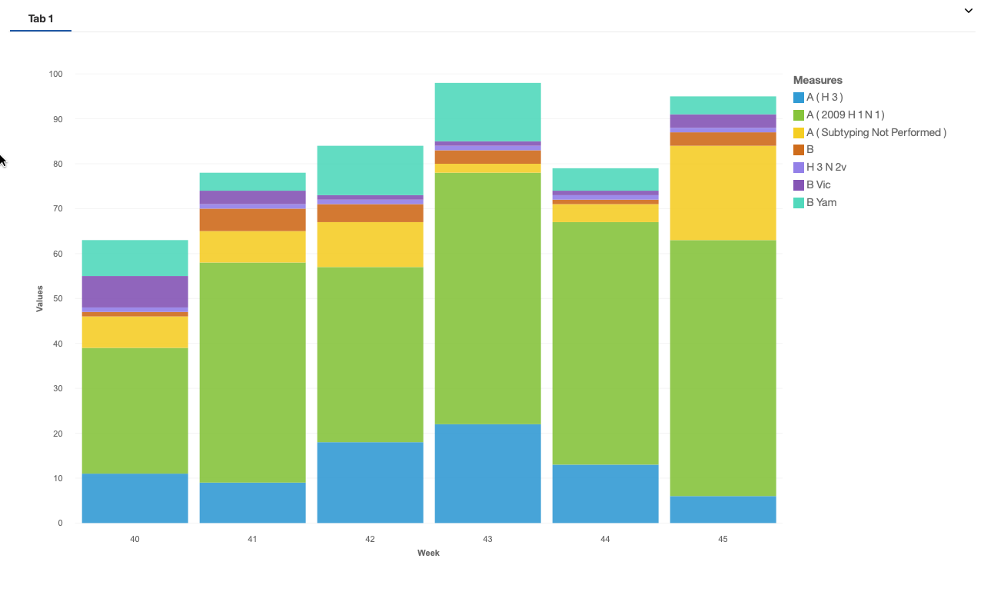
Ili and viral
Influenza Positive Tests Reported to CDC by Public Health Laboratories, National Summary, 2018-19 Season, week ending Nov 10, 2018.
Here each color represents different entity

Slide 7
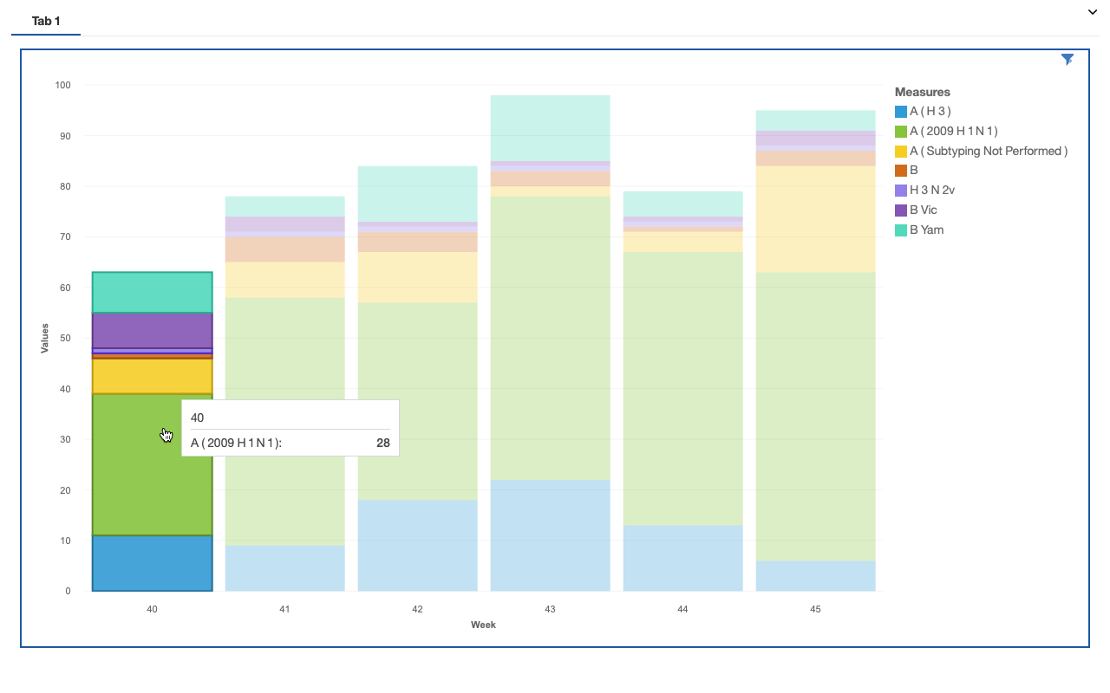
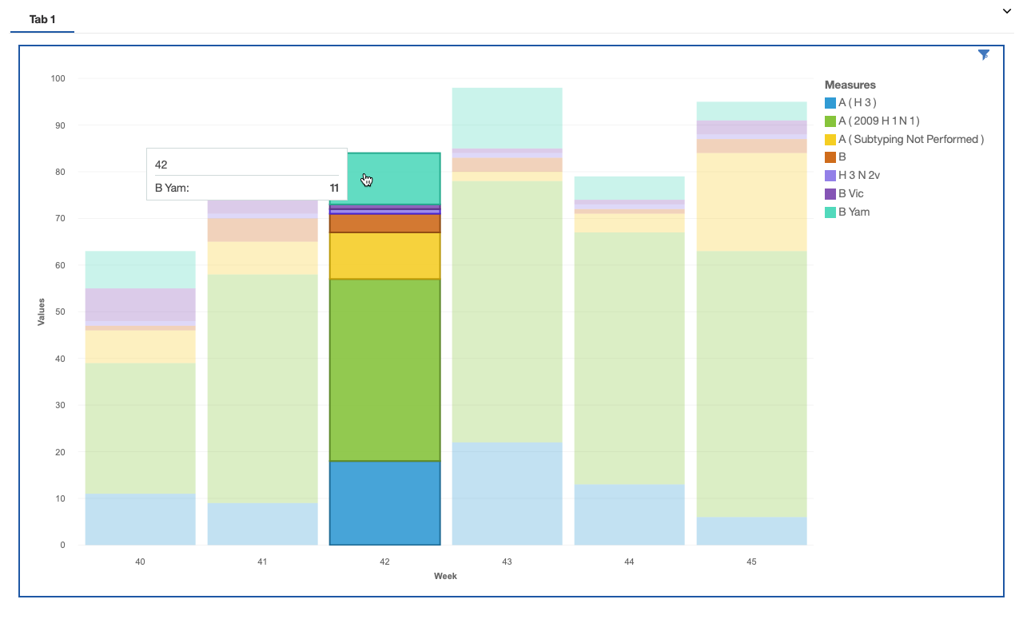
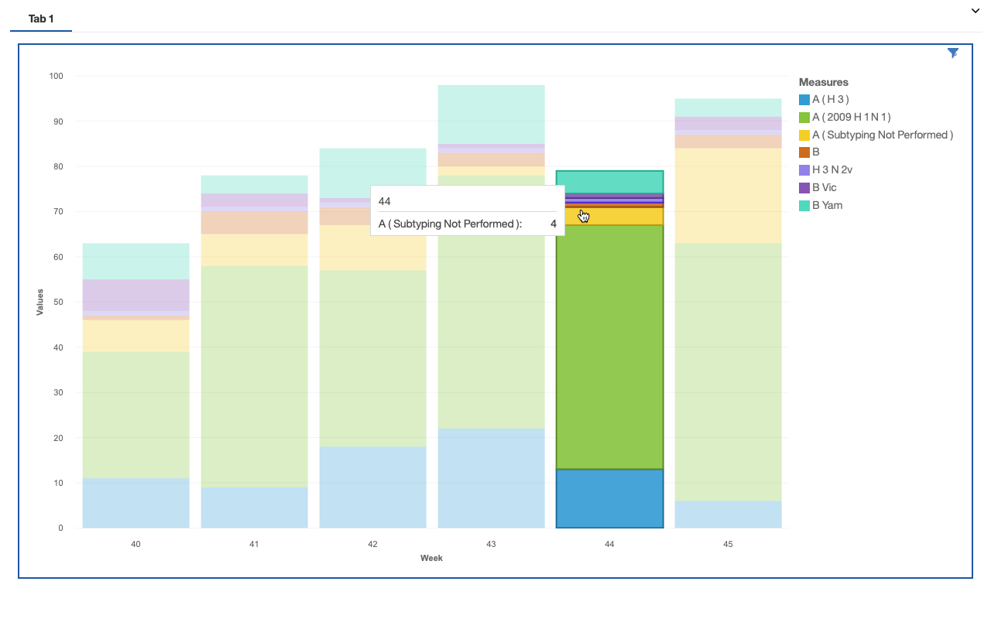
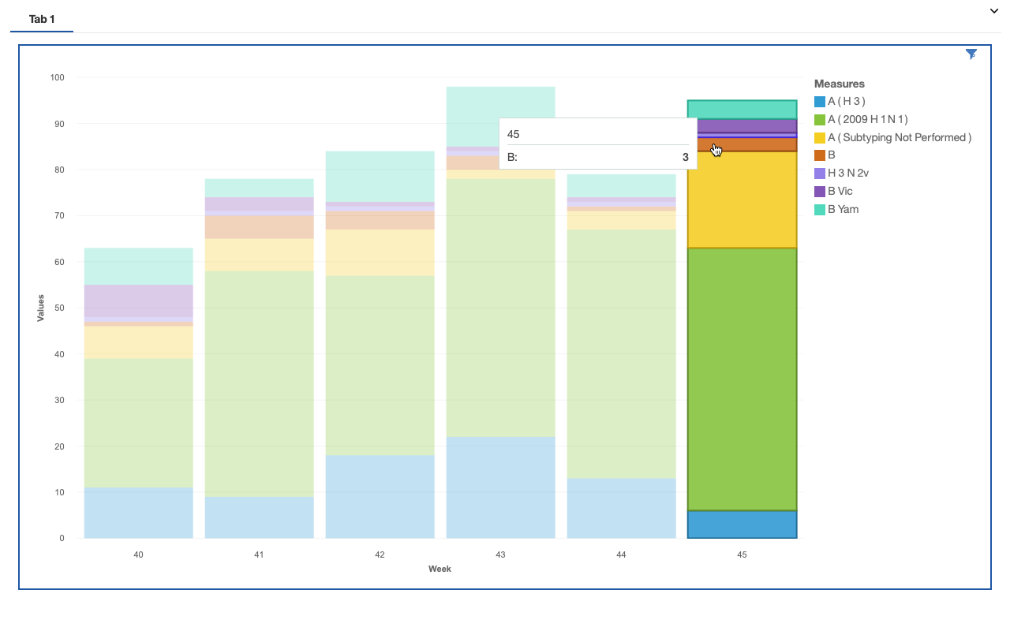
Customized View of each bars
Hovering the cursor in each color reveals detailed information about the entity.

Slide 8
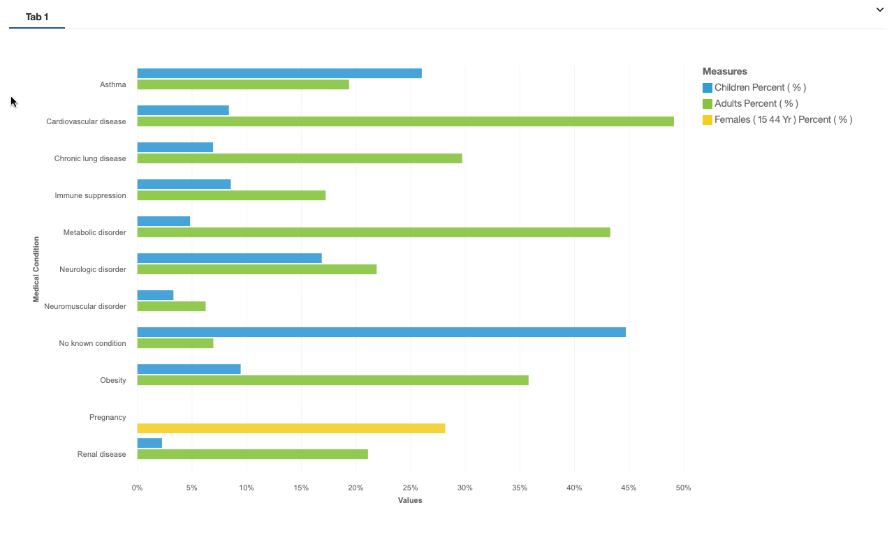
Hospitalization
Influenza-Associated Hospitalizations surveillance with horizontal Bar graph.

Slide 9
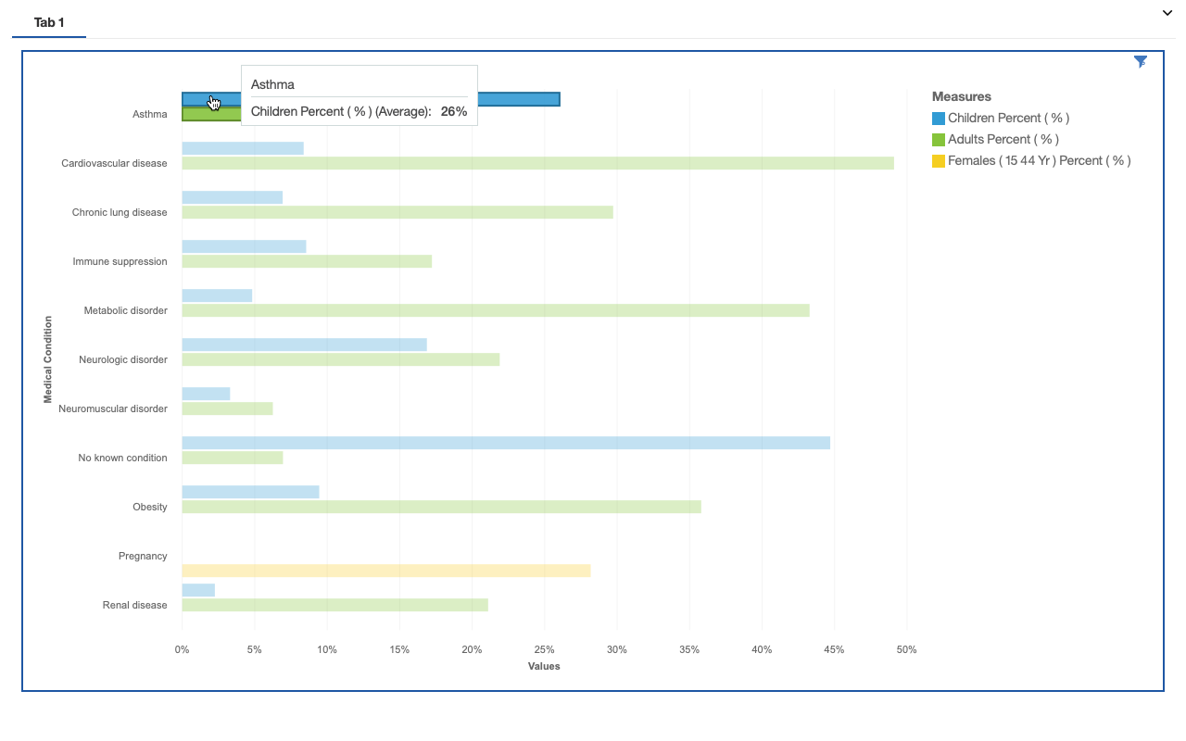
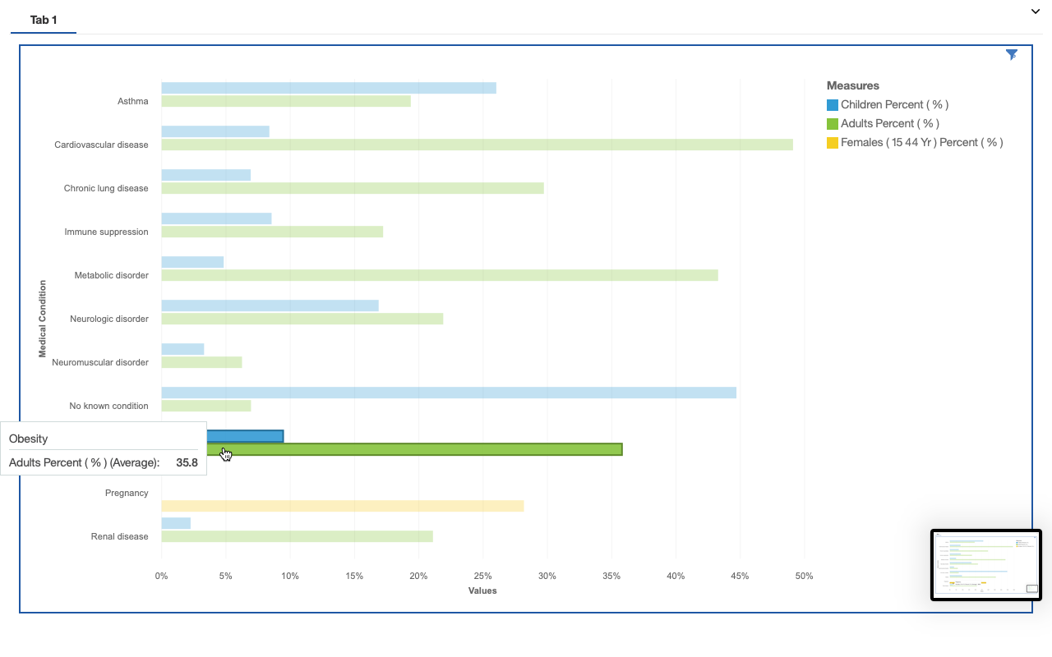
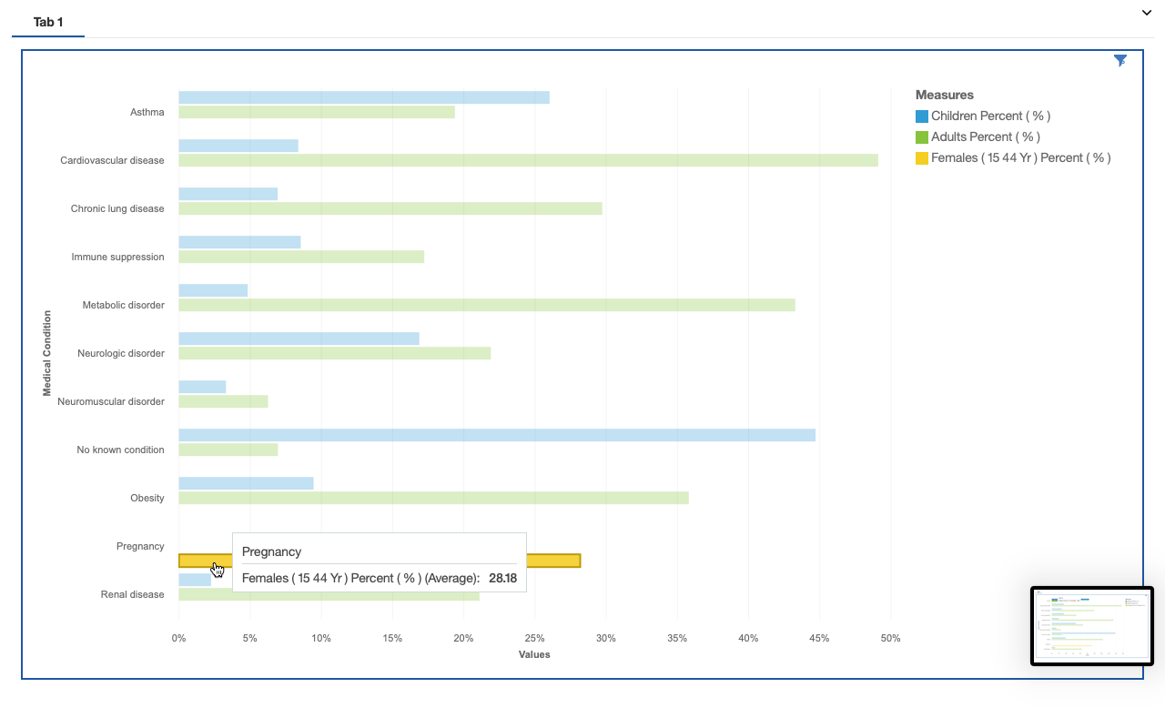
Hovering reveals details
Each color reveals different gender and children and during what disease they were hospitalized.

Slide 10
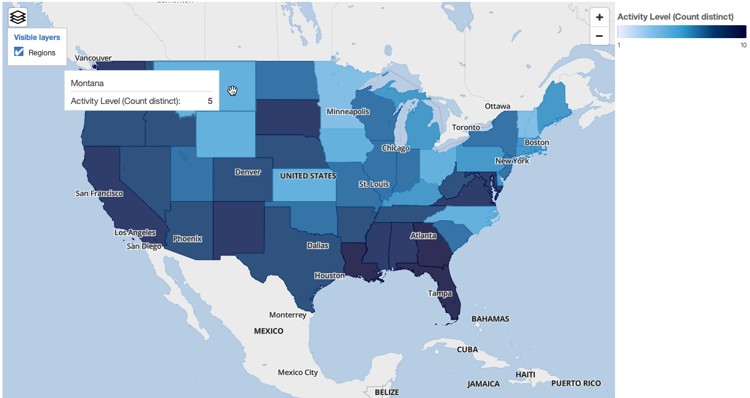
Influenza-Like Illness (ILI) Activity map
Activities Related to ILI represented in a Map
Activities mapped where darker state represents higher level of ILI activity compared to lighter states. (Level 1 - Level 10)

Slide 11
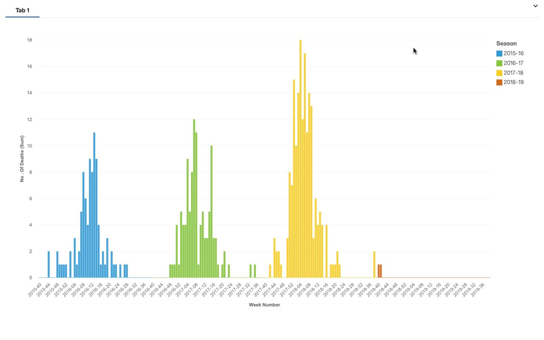
Paediatric mortality
Child Mortality grouped by season 2015-2019 represented on Column Chart.

Slide 12
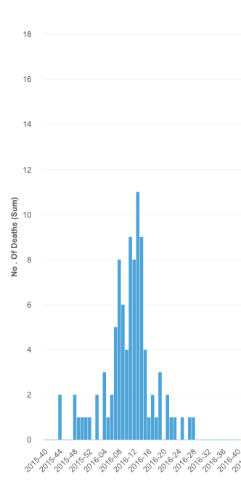
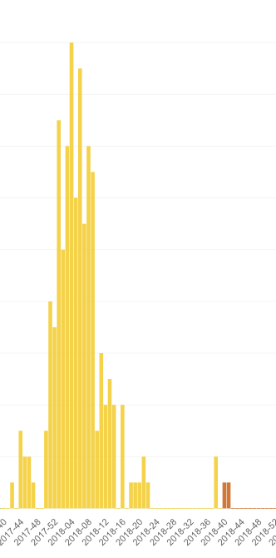
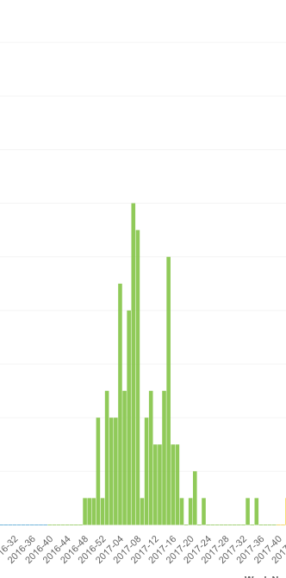
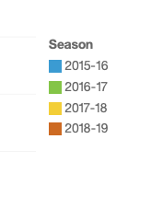
Each color represents different season

Slide 13
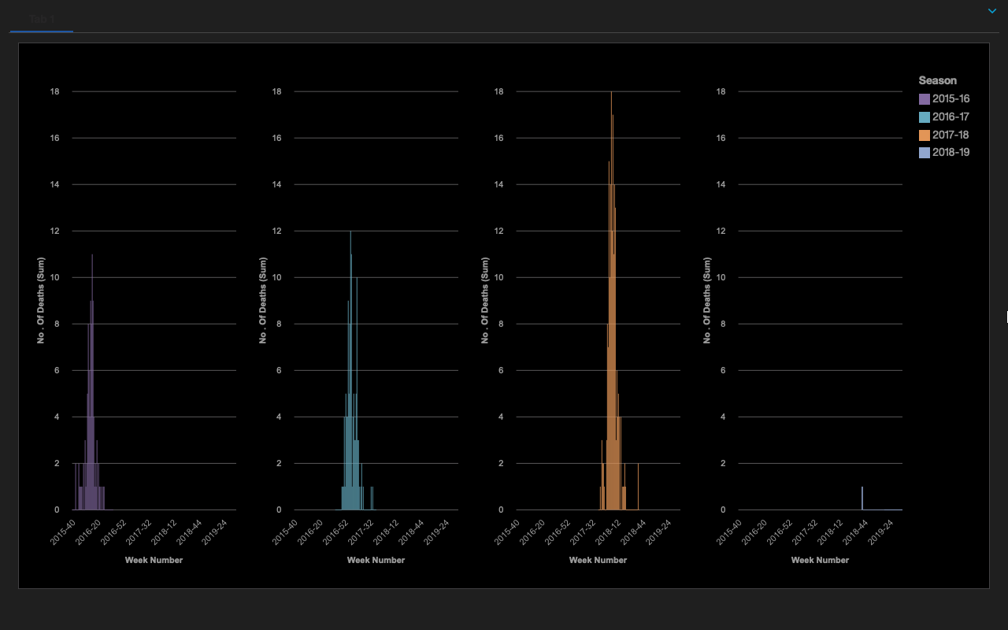
Season-wise visualization
We can separate the visualization by seasons where it shows different charts for each season.

Slide 14
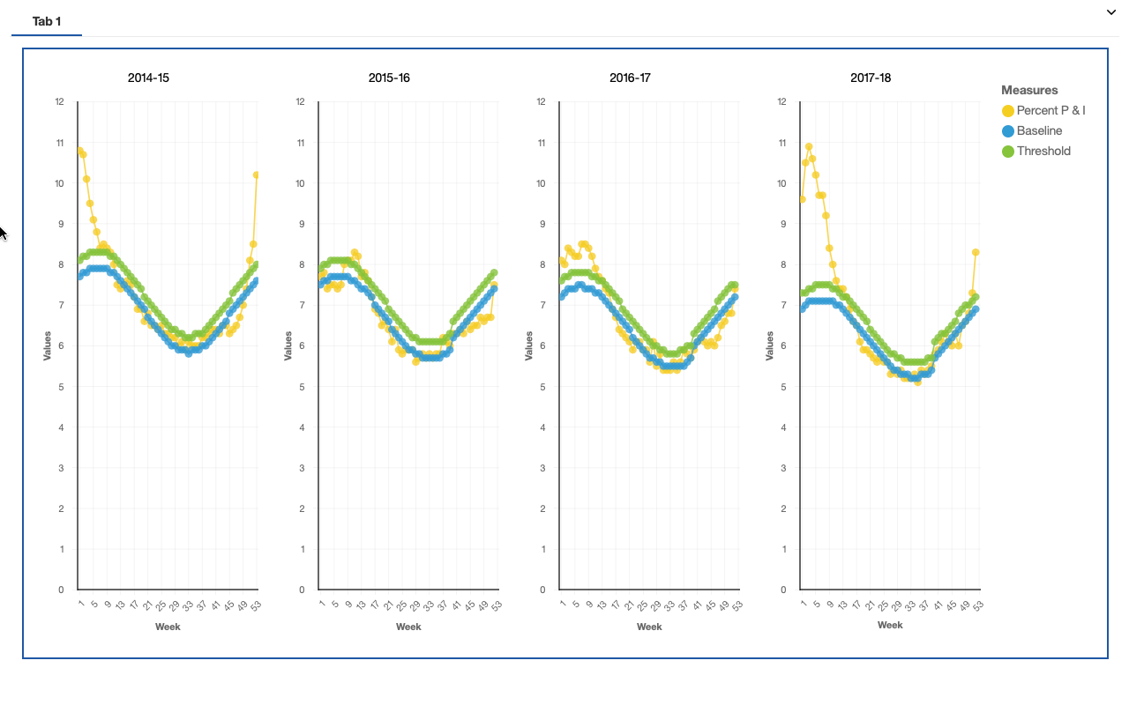
P & I Mortality
Surveillance of Death caused due to Pneumonia and Influenza represented on a Line Chart
Here each chart represents death caused by Pneumonia and Influenza from year 2014 - 2018.

Slide 15
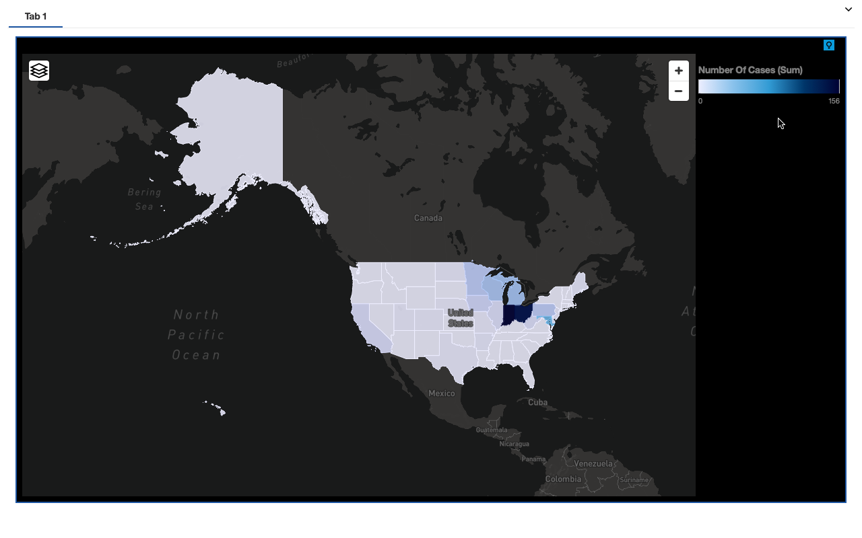
Novel Flu A
Novel Influenza A Virus Infections Cases by State
Here lighter region represents less number of cases while darker region with more number of cases.

Slide 16
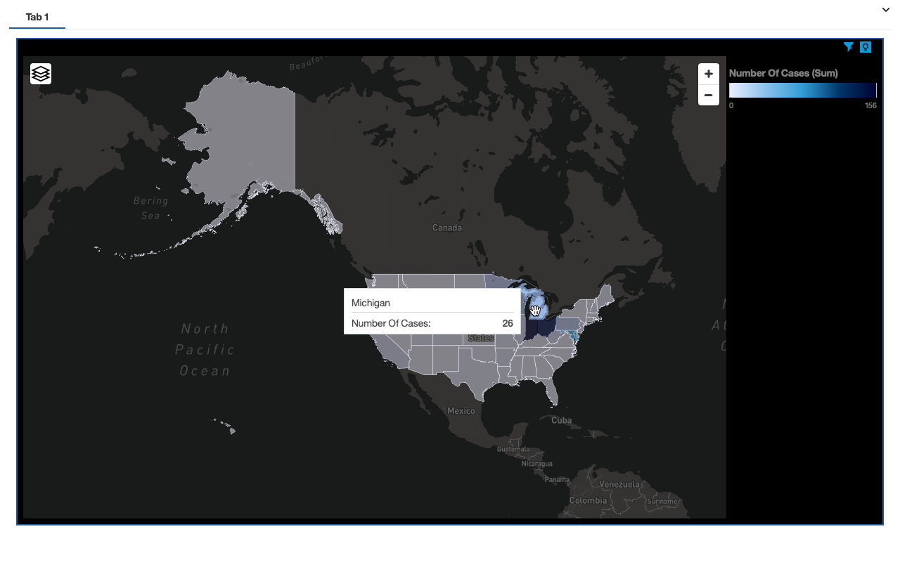
Hovering cursor reveals details
Hovering cursor on a specific region reveals more details like name of state and number of cases.

Slide 17
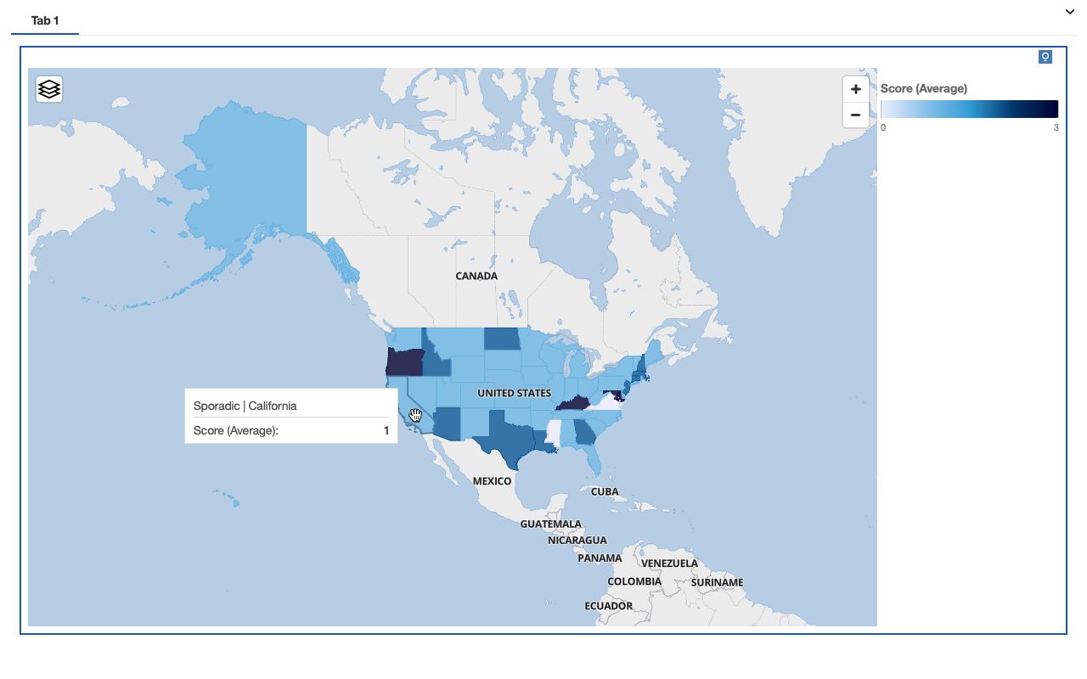
Geographic spread
State and Territorial Expert’s Report on Geographical Spread of Influenza.
Here Light Blue Color Represents Sporadic Activity, Medium Dark Blue Represents Local Activity and Dark Blue Represents RegionalActivity.

